Slide 1
﷽
Student Management System Project using OOP
Name : Ammar Jahangir.
Class : BS CS 2ND (Evening).
Roll No: B230313085.
Instructor: Honourable Mam Sheeba Razzaq.
Submission Deadline: 27-11-2024.

Slide 2
Contents of the presentation
01
02
03
Coclusion
Overview
System Design And Functionality

Slide 3
01
Overview
Introduction.
Objective.
Key Features.

Slide 4
Introduction:
The Student Management System is a C++ project designed to manage student data effectively with role-based functionality. The system includes:
Admin Role: Allows administrators to log in, add, update, and delete student records.
Student Role: Enables students to view their data using their roll number.
This project demonstrates the implementation of Object-Oriented Programming (OOP) concepts such as inheritance and polymorphism, ensuring a structured and user-friendly approach.

Slide 5
Objective:
To demonstrate the application of Object-Oriented Programming (OOP) principles:
Inheritance: To structure functionalities and extend system capabilities.
Polymorphism: To enable dynamic execution of operations like displaying user-specific data.
To utilize file handling for storing and managing data securely and efficiently.
To create a system for efficient management of student records, including adding, updating, searching, and viewing data.
To ensure a robust system design that is scalable, secure, and user-friendly.
To provide a practical example of applying C++ programming concepts to solve real-world problems.

Slide 6
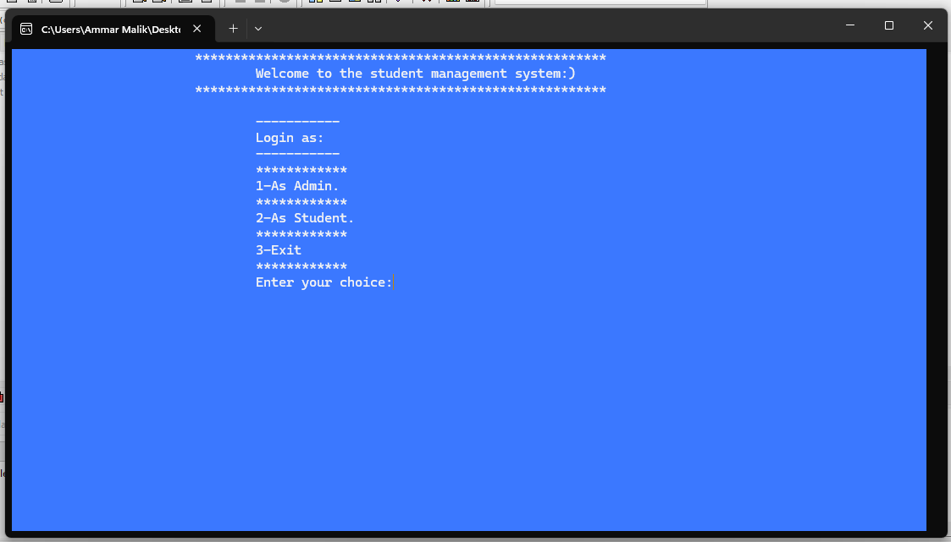
Key Features:
Login Page
Role-Based Access:
The system includes a secure login feature for two roles:
Admin: Can log in to manage student records (add, update, delete).
Student: Can log in to view their data using their roll number.
Secure Authentication: Ensures only authorized users can access specific functionalities.

Slide 7
02
System Design And Functionality
System Architecture.
Workflow.
Core Functionalities.

Slide 8
System Architecture
01
Admin
(Add,Update,View,Delete).
Login
Page
02
Student
(Only see data by roll number).
03
Exit
Both Admin and Student can terminate Program.

Slide 9
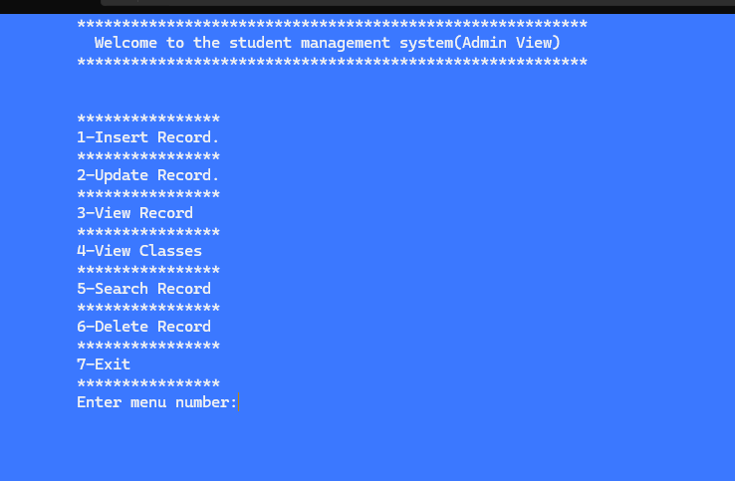
Workflow:
Admin:
When Admin login to system, he/she can easily perform following Operations:
Add data.
Update Data.
View Data.
Delete Data.
Search Record.
View Classes.
Exit the Program.

Slide 10
Admin View
01
Add Data.
04
Delete Records.
02
Update Data.
05
Search Record.
03
View Records.
06
Exit.

Slide 11
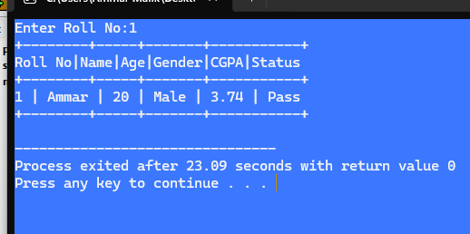
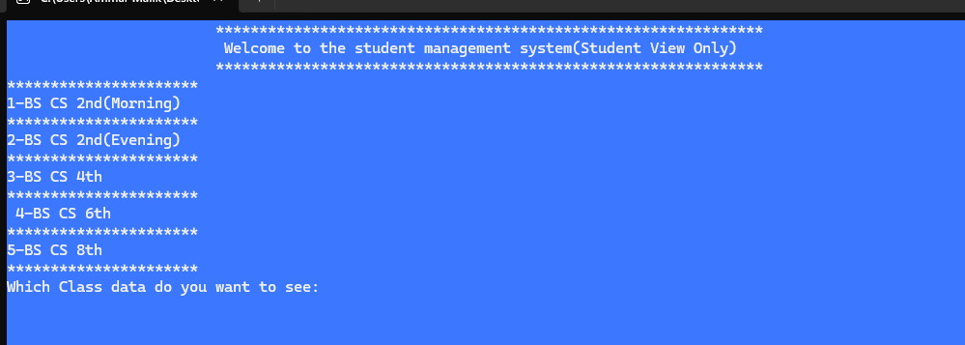
Workflow:
Student:
When student login into system, he/she can easily perform following Operation:
He/she can only view data by inserting there roll number.

Slide 12
Core Functionality:
Data Management: Efficiently store, update, and retrieve data for enhanced performance.
User Authentication: Secure login system with password encryption and role-based access control.
File Handling: Read, write, and update records in text and Excel files seamlessly.
Error Handling: Detect and manage errors with user-friendly feedback messages.
Report Generation: Create and export detailed reports in various formats (e.g., Excel, PDF).
Navigation: After completing each task, you have the option to return to the main menu or log out, allowing you to easily access the data again.

Slide 13
03
Conclusion

Slide 14
In conclusion, this project has successfully demonstrated key programming concepts such as inheritance and polymorphism. By implementing inheritance, we have learned how to extend and reuse functionality in a more efficient manner, while polymorphism has allowed us to work with different object types through a common interface. Additionally, we have gained hands-on experience in file handling, including reading, writing, deleting, and updating data, which are essential skills for managing persistent data in any application. These achievements have enhanced our understanding of object-oriented programming and file management, preparing us for more advanced programming tasks in the future. Through this project, we have strengthened our problem-solving abilities and improved our ability to create efficient, user-friendly software solutions.

Slide 15
Resources
Youtbe.com/@codewithharry
Youtbe.com/@Learncoding.

Slide 16
Thanks!
Do you have any questions?

